Slide 1
Lyrics Generator with NLP models
CS662/Info662 Final Project
Dawson Sargent, Chenghui Song, Kelvin Yi

Slide 2
Aims/Abstract
Dataset: 2 csv files from https://www.kaggle.com/datasets/neisse/scrapped-lyrics-from-6-genres?select=lyrics-data.csv
Generate corpus with lyric sentences
Train NLP models to generate text that mimic the input strings
Cell-based RNN
LSTM with Markov chains
GPT-2
Model evaluation
BLEU
BLEURT

Slide 3
Procedure
Data preprocessing
Original csv files
Lyric corpus
NLP models
Model training
RNN (single char)
LSTM with Markov chain (words)
GPT-2 (words)
Text generation
Model evaluation
BLEU score

Slide 4
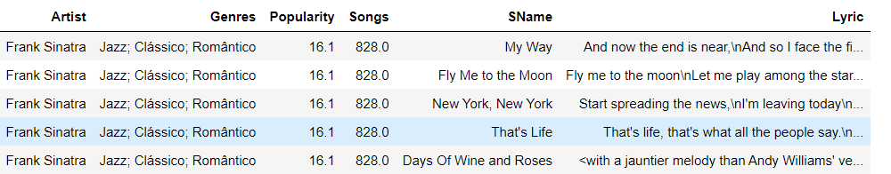
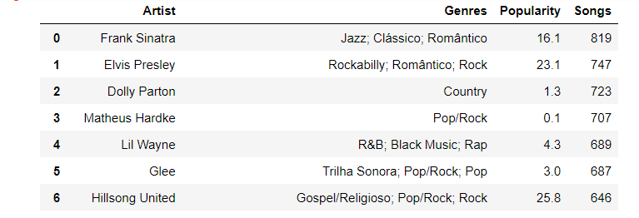

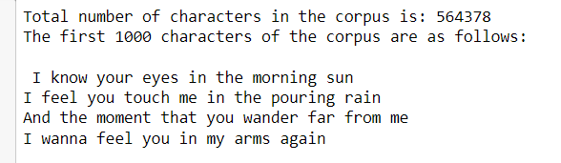
Data Preprocessing
Data source: 2 csv files (lyrics-data.csv and artists-data.csv) from
https://www.kaggle.com/datasets/neisse/scrapped-lyrics-from-6-genres?select=lyrics-data.csv
1. Create dataframe of artists and their songs
2. Create list most popular artists and # of songs in this dataset
3. Select an artist to generate the lyric corpus

Slide 5
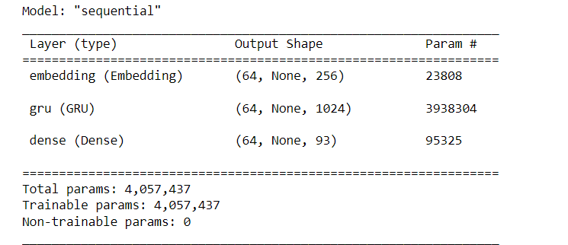
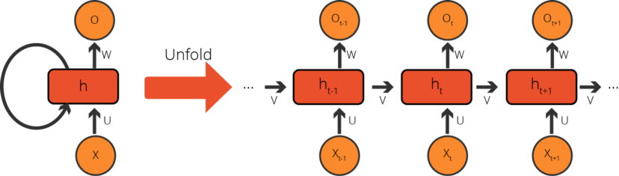
Model 1 (RNN): characters as input sequences
Vectorizing the Text
Find all unique characters from the corpus (vocab)
Assign a number to each character
Char-to-index
Index-to-char
Example of input-output layers of the model
Vectorize the whole corpus
de-vectorize (Decoding)
More about the model:
Adam as optimizer
sparse categorical crossentropy function as loss function
TensorFlow Dataset object
Batches (max 100 chars per seq)
Train the model and save the weights
Build a new model with epoch = 1 and saved weights
Generate New Text
A Cell-Based Recurrent Neural Network Activity

Slide 6
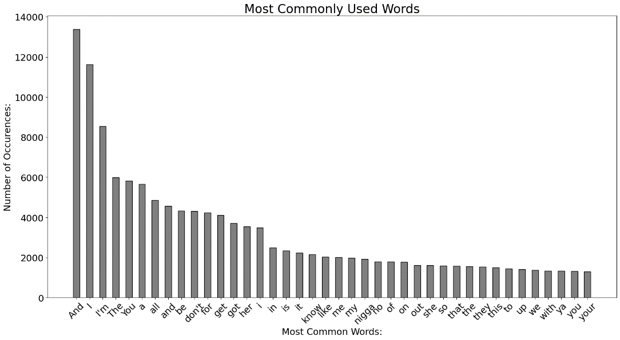
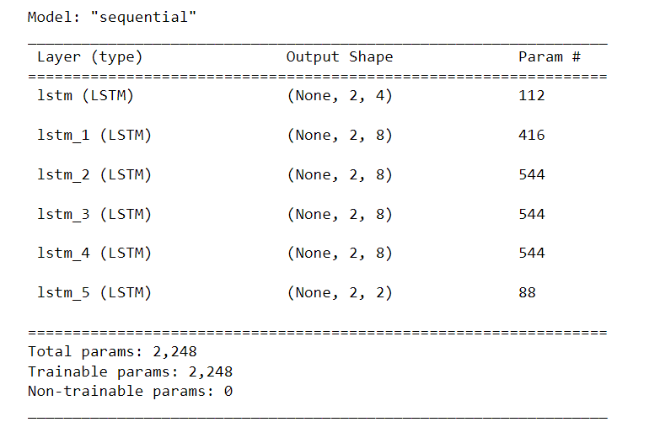
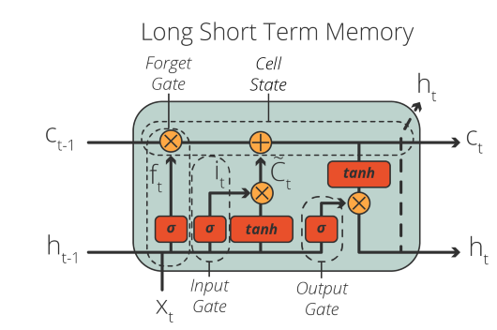
Model 2 (LSTM with Markov Chains): words as input sequences
Plot most commonly used words
Separate each line of the input txt
Determine the rhyme scheme and verse
Determine number of syllables in each line
Make index of words that rhyme with the word
Make index of rhymes
Input-output layers of the model
Compose verse
Build dataset
Model with LSTM layers and Markov Chain

Slide 7
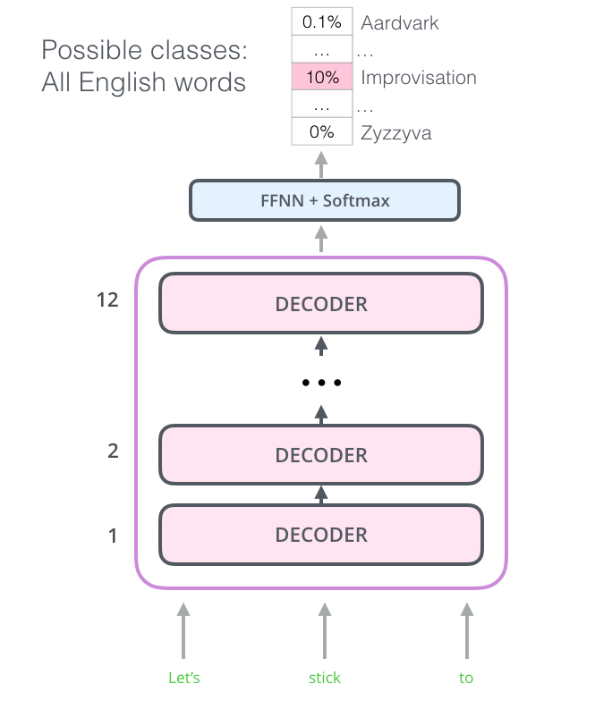
Model 3 (GPT-2): tokens as input sequences
Lyric corpus
Song Titles
Song title – lyrics pairs
Tokenize
Vectorize
Train the model
GPT-2 model
Generate fake titles
Reload the model and generate lyrics

Slide 8
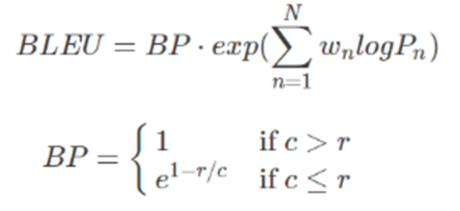
Model evaluation (BLEU score)
Problems with BLEU
It doesn’t consider meaning
It doesn’t directly consider sentence structure
It doesn’t handle morphologically rich languages well
It doesn’t map well to human judgements
BLEURT?
A trained metric that based on BERT and RemBERT
Takes a pair of sentences as input, a reference and a candidate
Returns a score that indicates to what extent the candidate is fluent and conveys the meaning of the reference
Notes:
BLEURT: Learning Robust Metrics for Text Generation
https://arxiv.org/abs/2004.04696
Metric: bleurt
https://huggingface.co/spaces/evaluate-metric/bleurt
BLEURT: a Transfer Learning-Based Metric for Natural Language Generation
https://github.com/google-research/bleurt

Slide 9
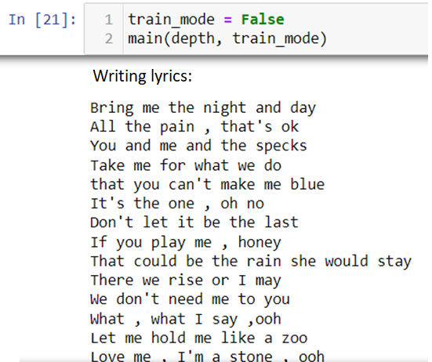
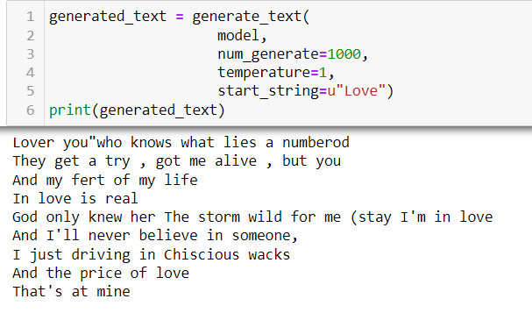
Results
Model 1
Model 2

Slide 10
Summary
About the corpus
Our code can create text corpus from any artists of choice
This is necessary because the styles vary between artists
Model 1 (cell-based RNN) - Chenghui Song
Learns the styles of the input text and generates similar text
Can generate text according to given phrases
Simple and fast but sometime generate non-sense words
Model 2 (LSTM with Markov Chains) – Chenghui Song
Learns the styles including the sequence words and rhythms of the sentences
Better for corpus with rhythms and verses
Cannot control the subject of the generated text
Generate same text if no parameters changed
Model 3 (GPT-2) - Dawson Sargent
From pretrained weights so expecting better performance
In progress
BLEU score - Kelvin Yi
In progress
Might not be able to evaluate all models because lacking reference sentences

Slide 11
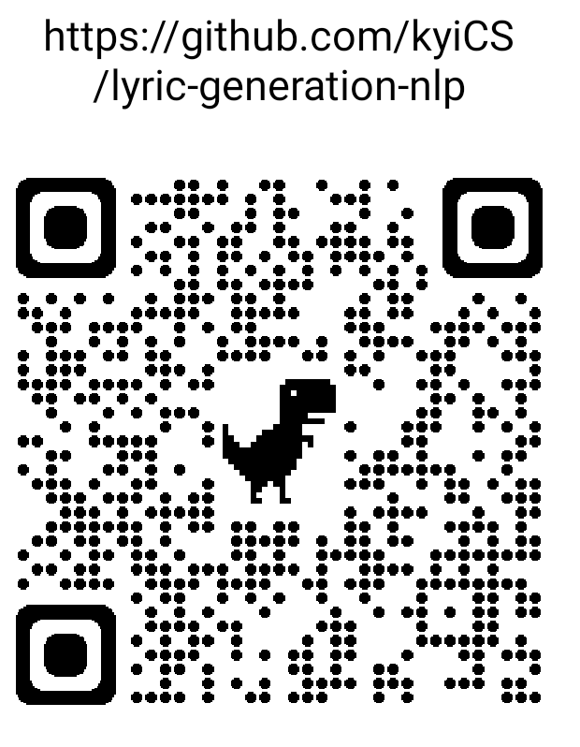
References
Dataset: https://www.kaggle.com/datasets/neisse/scrapped-lyrics-from-6-genres?select=lyrics-data.csv
Create Your Own Artificial Shakespeare in 10 Minutes with Natural Language Processing https://towardsdatascience.com/create-your-own-artificial-shakespeare-in-10-minutes-with-natural-language-processing-1fde5edc8f28
Poetry Generator (RNN Markov)
https://www.kaggle.com/code/paultimothymooney/poetry-generator-rnn-markov
GPT-2 Model card https://huggingface.co/gpt2
Train GPT-2 in your own language
https://towardsdatascience.com/train-gpt-2-in-your-own-language-fc6ad4d60171
Training a GPT-2 Model From Scratch
https://docs.aitextgen.io/tutorials/model-from-scratch/
A Gentle Introduction to Calculating the BLEU Score for Text in Python
https://machinelearningmastery.com/calculate-bleu-score-for-text-python/
How to calculate BLEU Score in Python?
https://www.digitalocean.com/community/tutorials/bleu-score-in-python
BLEURT: a Transfer Learning-Based Metric for Natural Language Generation
https://github.com/google-research/bleurt

